Slide 1
雲端計算 Cloud Computing
IaaS,PaaS, SaaS case study

Slide 2
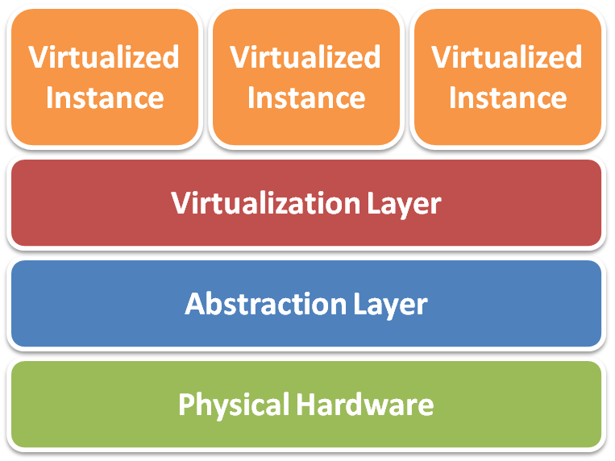
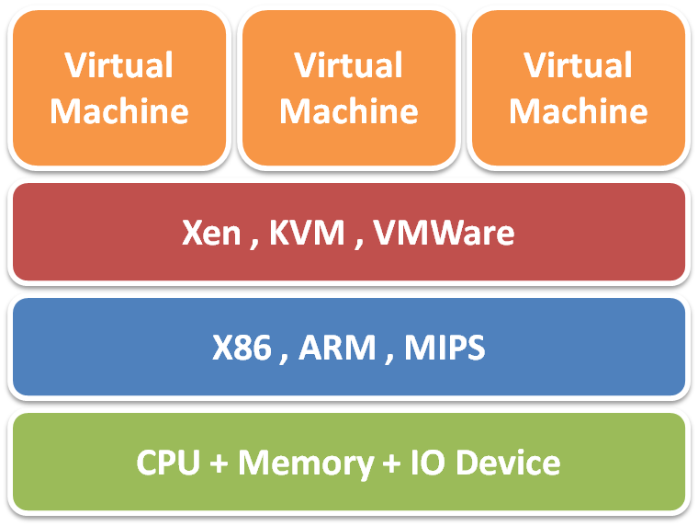
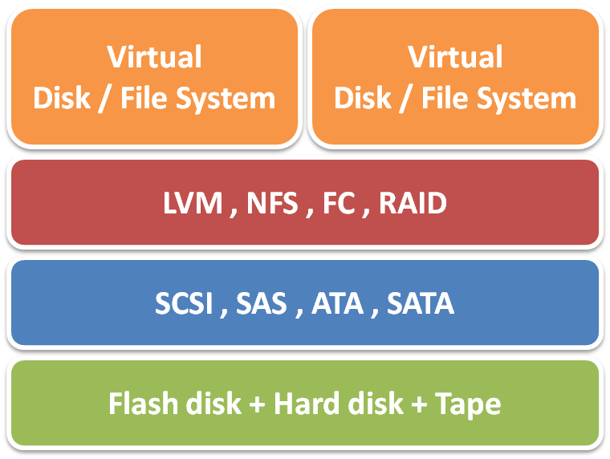
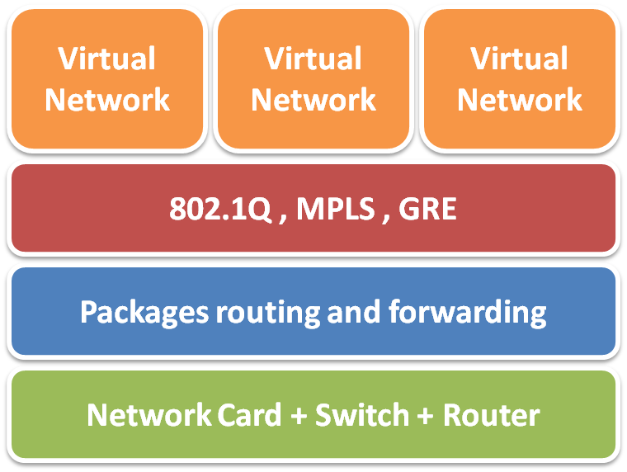
IaaS Virtualization
Virtualization techniques
Server Virtualization
Storage Virtualization
Network Virtualization

Slide 3
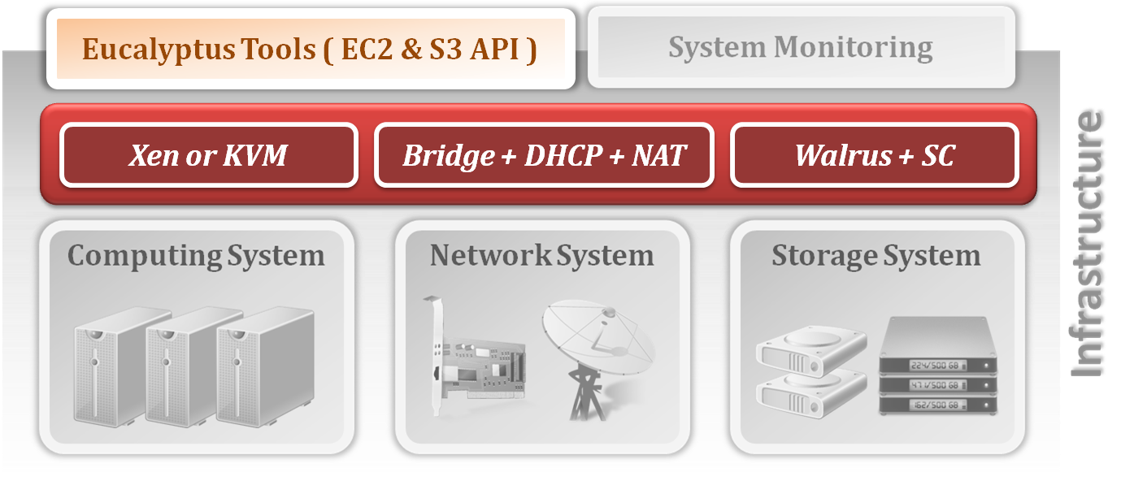
IaaS Case Study
IaaS open source project – Eucalyptus
Elastic Utility Computing Architecture for Linking Your Programs to Useful Systems
IaaS Architecture of Eucalyptus

Slide 4
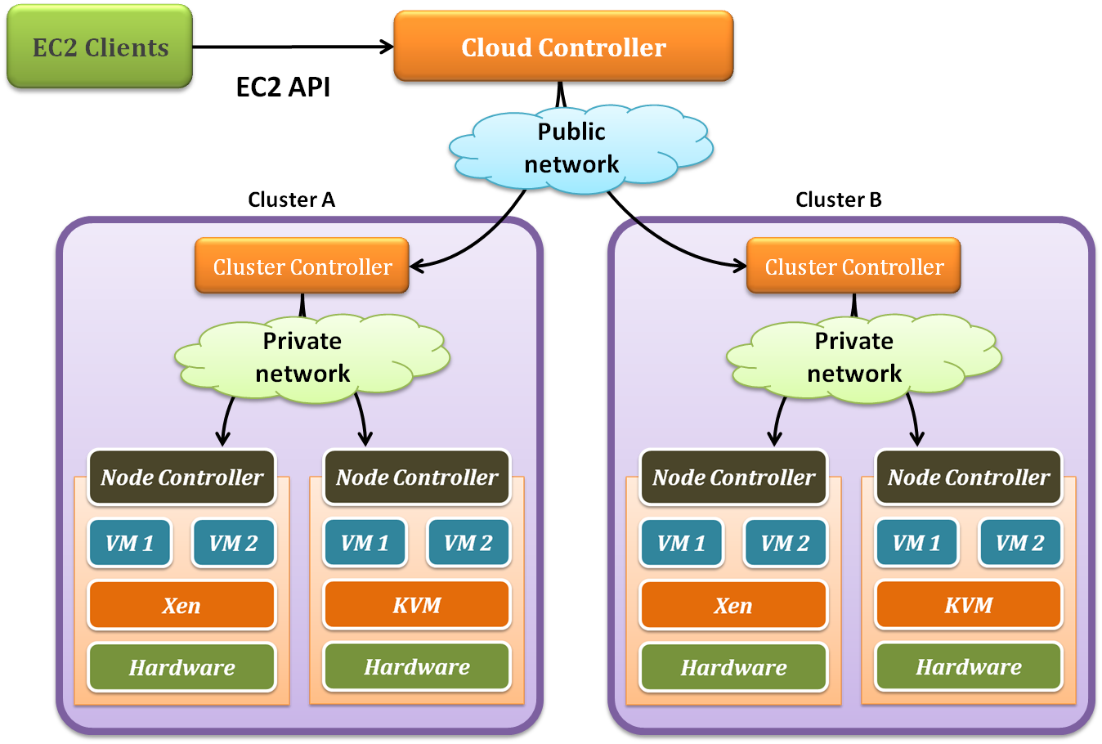
IaaS Case Study
Server Virtualization

Slide 5
IaaS Case Study
System Component :
Cloud Controller (CLC)
Dispatch user request to some clusters.
Cluster Controller (CC)
Determine enough resource for virtual machine deployment.
Node Controller (NC)
Run user’s virtual machines.

Slide 6
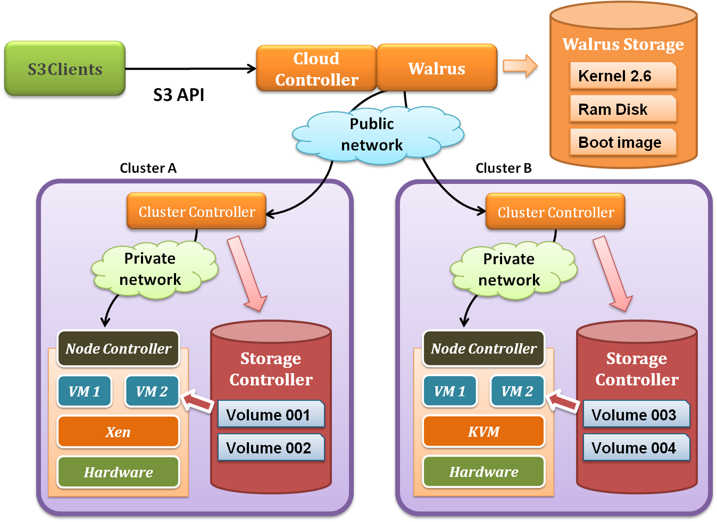
IaaS Case Study
Storage Virtualization

Slide 7
IaaS Case Study
Two kinds of storage systems :
Walrus ( S3 compatible )
Mainly store the images, which provided by users or administrator, for VMs booting.
Storage Controller
Mainly store user created logical volumes which can be attached to specified VMs in run-time.
Each storage controller in a cluster is controlled by the corresponding cluster controller, and each VM can utilize these logical volumes through networks.

Slide 8
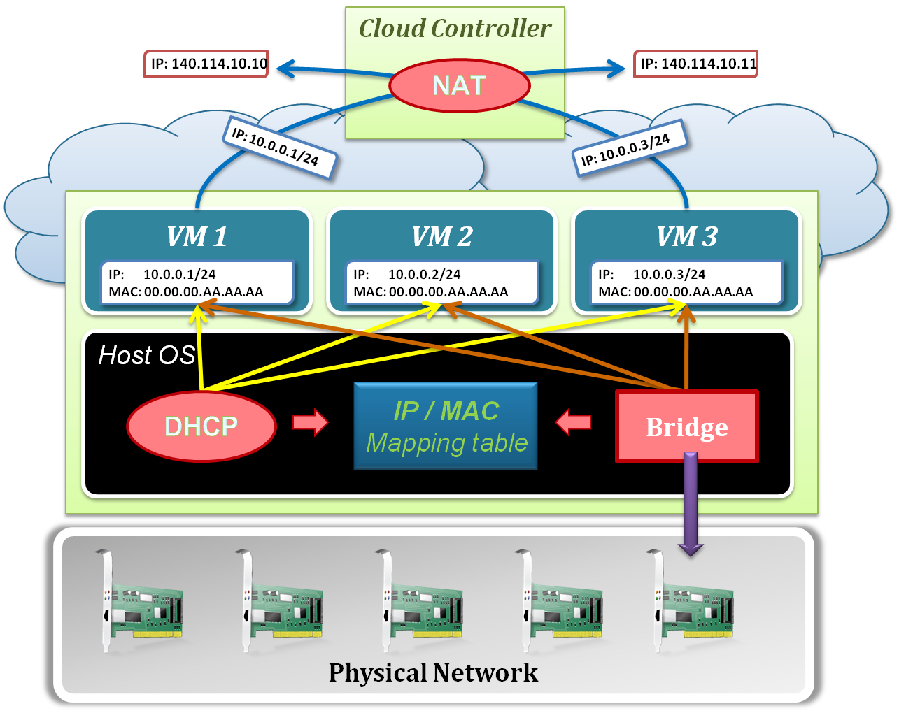
IaaS Case Study
Network Virtualization

Slide 9
IaaS Case Study
Network architecture :
Bridge ( Virtual Switch )
Make virtual machines on one node share physical NICs.
DHCP
Map virtual MAC addresses of VMs to private IPs in the LAN.
NAT
Forward the packages to public network (WAN).
IP/MAC mapping table
IP addresses are assigned by Eucalyptus.
MAC addresses are assigned by hypervisor.
This mapping table is maintained by Eucalyptus system.

Slide 10
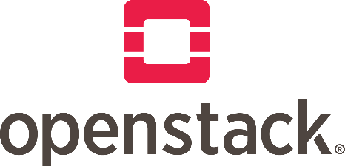
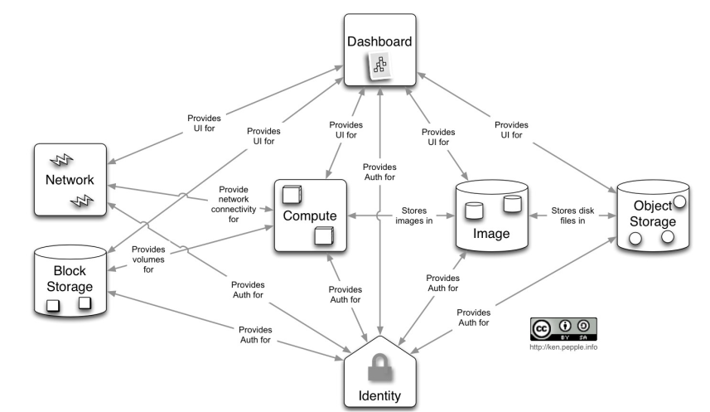
IaaS Case Study
Opensource project: OpenStack

Slide 11
IaaS Case Study
OpenStack
Dashboard (Horizon):
Provides GUI console via Web browser
Compute (Nova):
Virtual Machine Management
Network (Neutron):
Virtual Networking Management
Storage (Cinder, Swift):
Swift: Provides Cloud Storage
Cinder: Storage Management for Virtual Machine
Identity (Keystone):
User management
Image (Glance):
Manages Virtual images

Slide 12
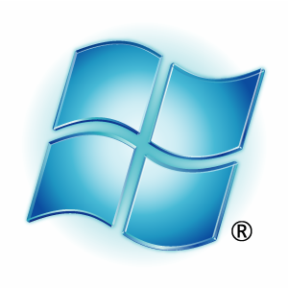
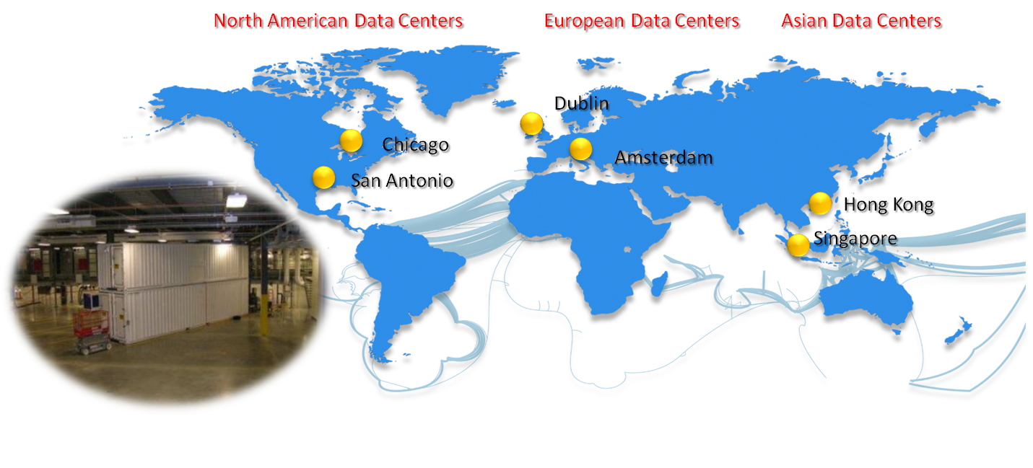
PaaS Case Study
Microsoft Windows Azure:
Windows Azure platform is one of PaaS vendors
Based on .NET and Microsoft’s supported development tools
Windows Azure starts general availability at Feb 2010, and builds the global data center around the world

Slide 13
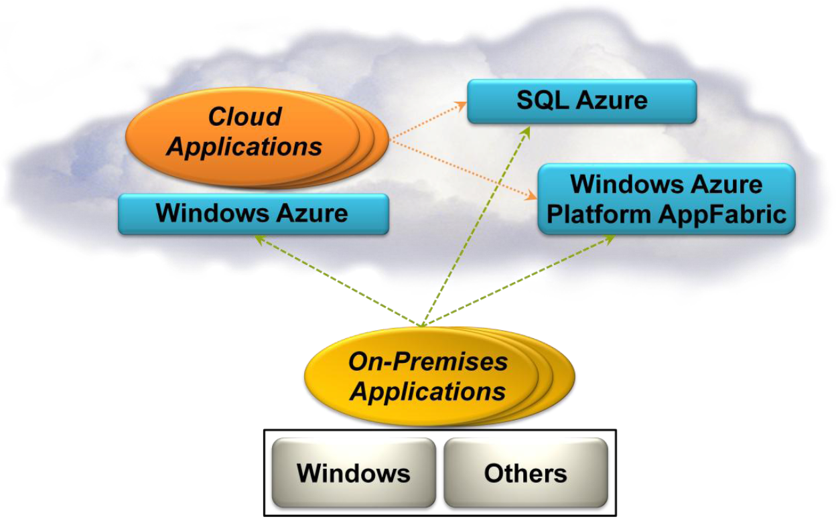
PaaS Case Study Windows Azure Platform
A group of cloud technologies, each providing a specific set of services to application developers

Slide 14
Major Components
PaaS Case Study Windows Azure Platform
Windows Azure
Provides a Windows-based environment for running applications and storing data on servers in Microsoft data centers
SQL Azure
Provides data services in the cloud based on SQL Server
AppFabric
Provides cloud services for connecting applications running in the cloud or on premises

Slide 15
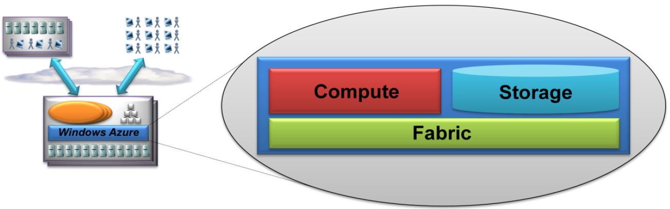
PaaS Case Study Windows Azure Platform
Windows Azure is a foundation for running Windows applications and storing data in the cloud
Provides Windows-based compute and storage services for cloud applications

Slide 16
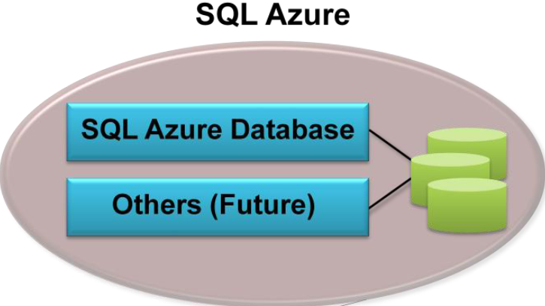
PaaS Case Study Windows Azure Platform
SQL Azure provides a cloud-based database management system (DBMS) and data-oriented services in the cloud

Slide 17
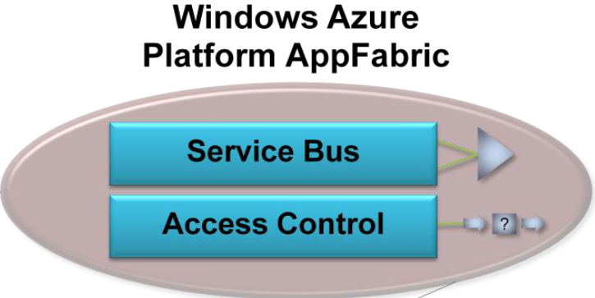
PaaS Case Study Windows Azure Platform
AppFabric provides cloud-based infrastructure in connecting distributed services and applications

Slide 18
SaaS Case Study
Google Workspace
a collection of cloud computing, productivity and collaboration tools, software and products developed and marketed by Google.
Gmail, Contacts, Calendar, Meet and Chat for communication;
Drive for storage;
the Google Docs Editors suite for content creation
WebOS
WebOS is a group of web applications that run as a operating system in Internet
Like web application, but more powerful
Provides many applications
Like notepad, music player …etc
Without a physical storage
instead, all data and application are in the server side

Slide 19

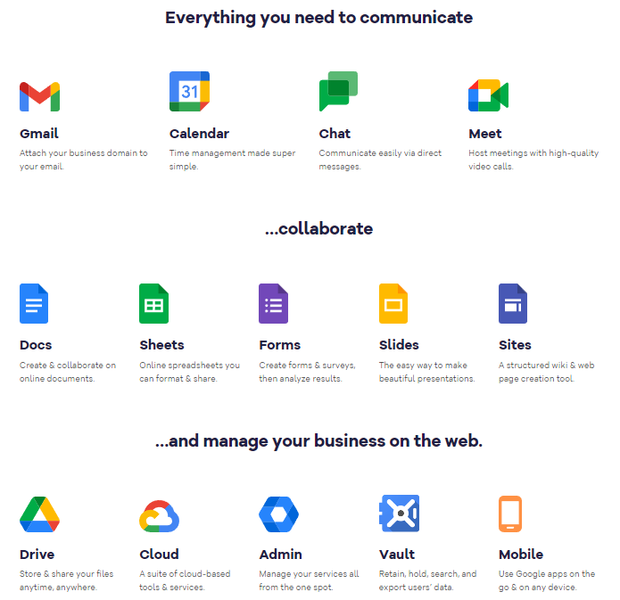
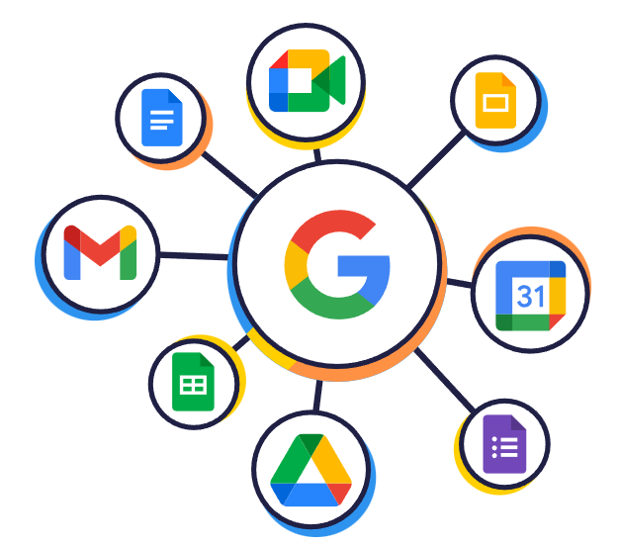
SaaS Case Study Google Workspace
Google Workspace is one of the popular SaaS service vendor
Website: https://en.wikipedia.org/wiki/Google_Workspace

Slide 20

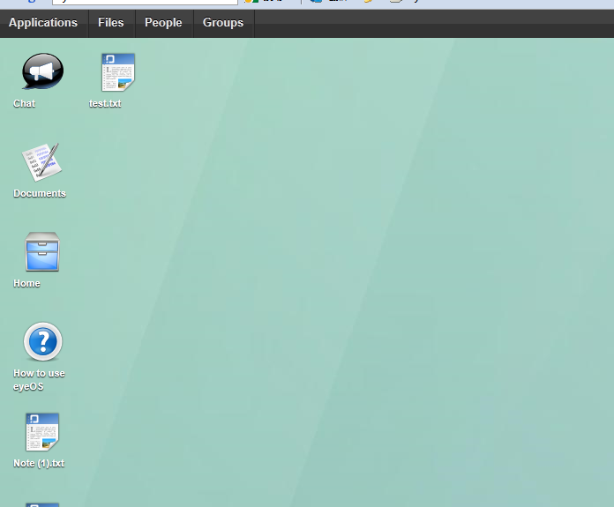
SaaS Case Study eyeOS
eyeOS is a open-source browser based web desktop
Based on LAMP
Work like a normal OS and simple to use
Just like use web application
Reduce the cost
A device with Internet access
A browser

